Slide 1
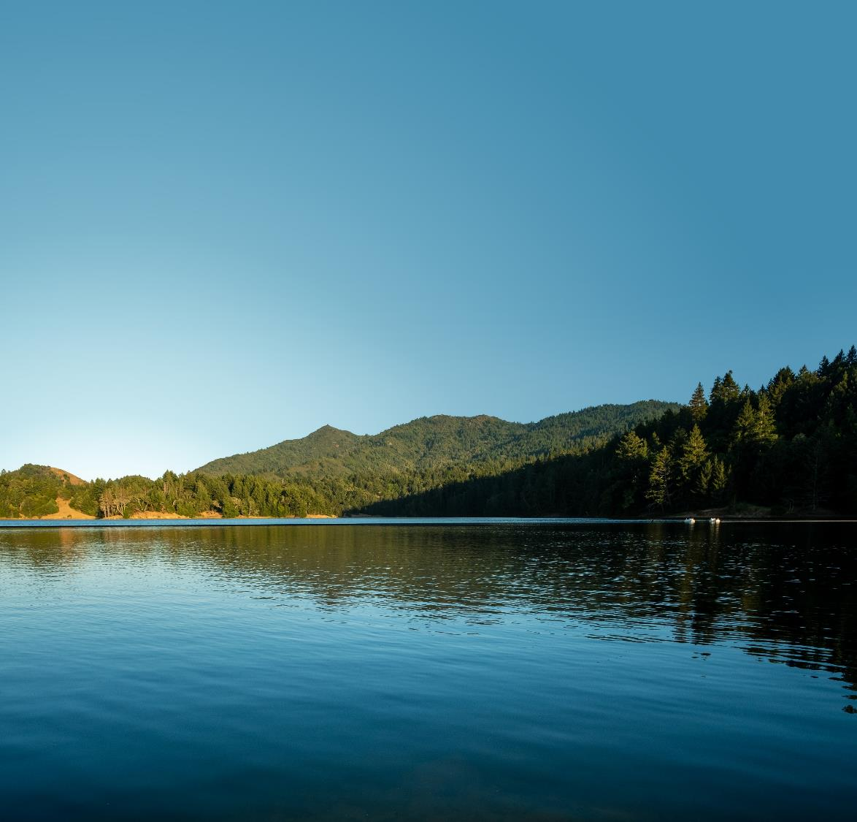
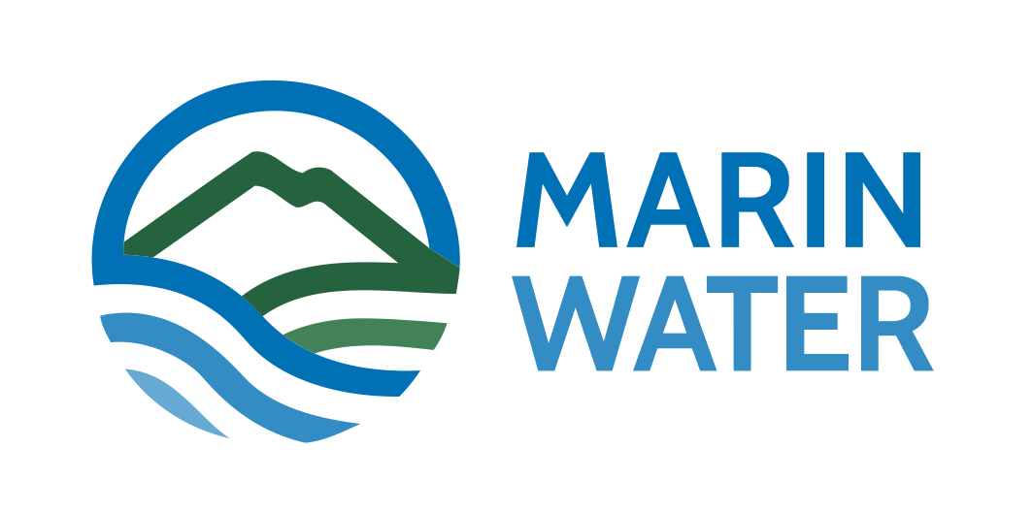
Update on MMWD’s Water Supply Planning Efforts
January 18, 2024
LGVSD Board of Directors Meeting

Slide 2
Overview
Marin Water and Water Supply Conditions
Strategic Water Supply Assessment
Current Recycled Water System and Future Opportunities
Q&A
Notes:
Ben

Slide 3
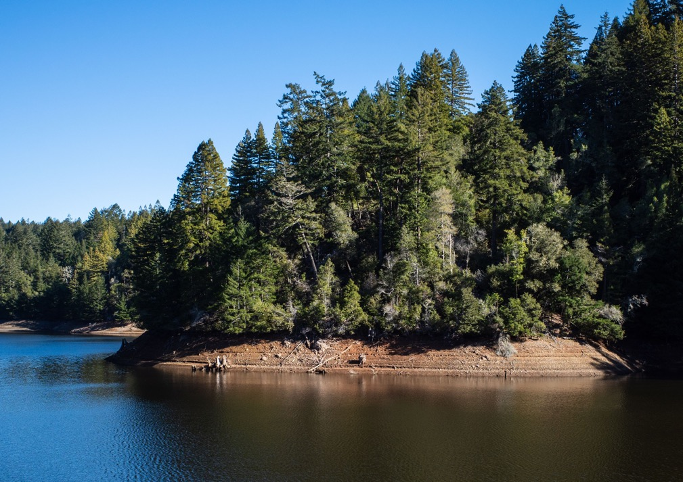
Marin Water Overview
California’s oldest municipal water district (Chartered in 1912)
Marin County’s largest drinking water provider, serving more than 191,000 people in central and southern Marin
Protecting and preserving 22,000 acres of watershed land on Mt. Tamalpais
3

Slide 4
Water Supply Conditions: 2020-2021 Drought
Fall 2021 Reservoir Projections
Severe drought conditions over the water years 2020 and 2021
Reservoir levels dropped historically low
MMWD shifted resources to planning for an emergency water supply – pipe across Richmond Bridge

Slide 5
Water Supply Conditions: 2020-2021 Drought
Exceedingly high rainfall totals in October & December 2021
Storage levels improved drastically in 3 month period:
February 2022 storage levels were 106% of historical average
Resulted in approx. 2 year supply in the local reservoirs
Transitioned to developing Water Supply Roadmap through Strategic Water Supply Assessment process

Slide 6
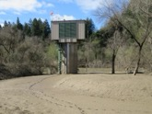
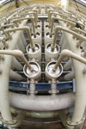
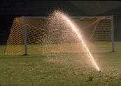
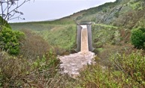
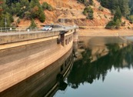
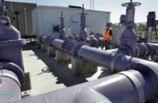
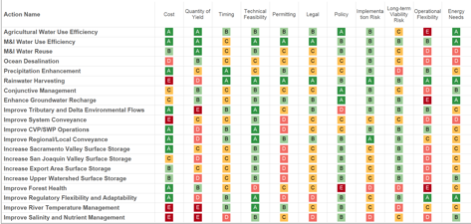

Water Supply Assessment Process
Increase Supply
Manage Demand
Modify Operations
Policy & Governance
Considered a broad range of water management alternatives
Identified most promising alternatives
Evaluated alternatives for performance and other economic, environmental, and social criteria
Explored strategic combinations of alternatives
Developed roadmap with specific project, pathways, and triggers to achieve resilient and sustainable solutions
Performance and Economic, Environmental, Social Attributes of Options
Portfolio Development and Analysis
A
B
D
C
Resilient and Sustainable Water Management Solutions

Slide 7
Roadmap for Integrated Strategy
In-District Improvements
$6M
Electrify Soulajule
$5M
Phoenix-Bon Tempe Connection
Forecasting and Stream Release Automation
Sonoma-Marin Partnerships
Operational Strategy for Maximizing Sonoma Water Supply
$78-111M
Conveyance to Storage (Dedicated or expand existing facilities)
Local Storage Enlargement
Increase Storage (Groundwater, Kent, Nicasio, Soulajule)
$65-90M
New Supply Development
Desalination (Petaluma Brackish, Marin Regional)
Recycled Water Expansion (grant funding to bring cost to comparable with roadmap)
Increase Conservation
Water Conservation Program
Note: Capital cost shown in $M
Early, low regret action
Hatching indicates not included in yield or cost estimates
~6,000 AFY of new supply
Mid-term action
~ 12,000 – 20,000 AFY of new supply
~ 3,500 AFY of new supply
Long-term action
Time
2025
2030
2035
2040
2045

Slide 8
Recycled Water

Slide 9
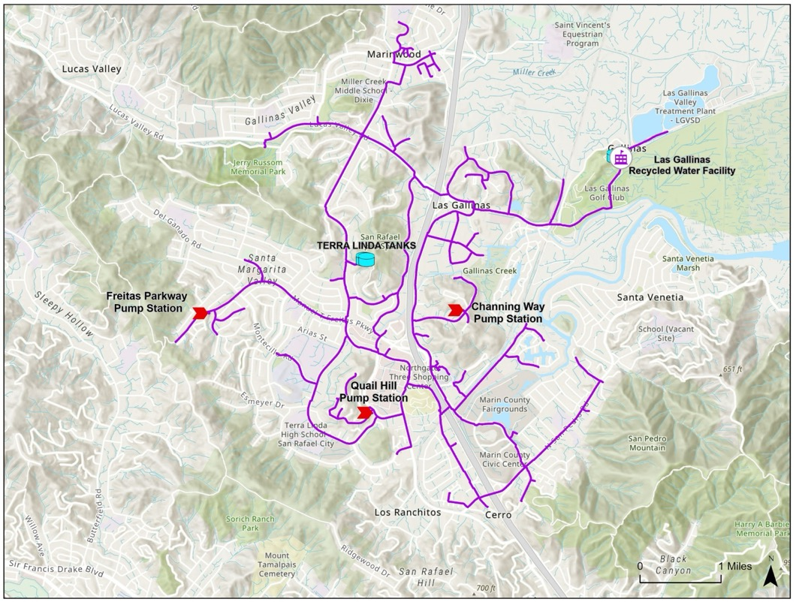
Current Recycled Water System
706 AF in WY 2023
358 customers
25 miles of distribution pipelines, 3 pump stations and 2 storage tanks
MMWD pioneered non-traditional uses of recycled water such as toilet flushing in condominium, car wash, HVAC cooling towers and commercial laundries
Truck hauling programs for residents (during drought) and commercial users
Notes:
A pilot plant was constructed in 1975 and was pressed into service during the drought of 1976-78.
In 1981, construction of a 1-MGD direct filtration plant was completed along with a backbone distribution system.
In 1989, the upgraded tertiary water recycling treatment plant was completed with 2-MGD capacity.
Since then conundrum as to how to afford expansion given the need for capital in other areas.

Slide 10
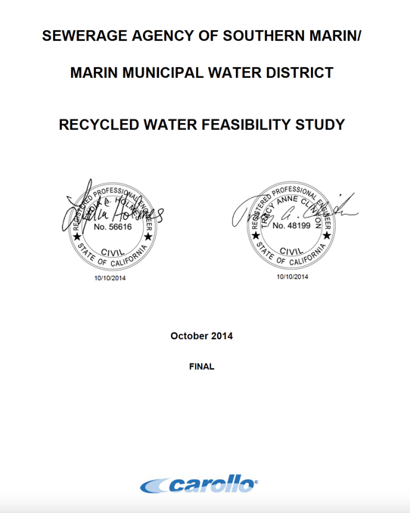
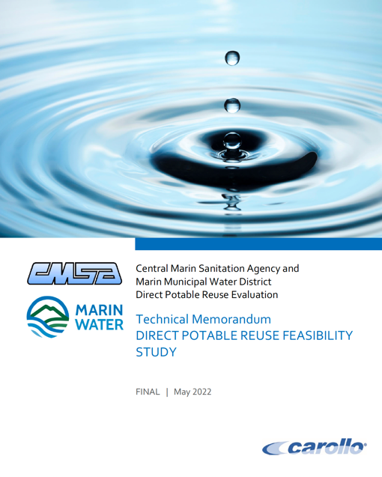
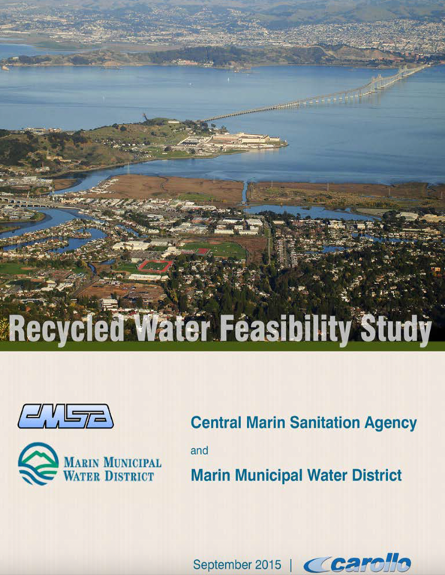
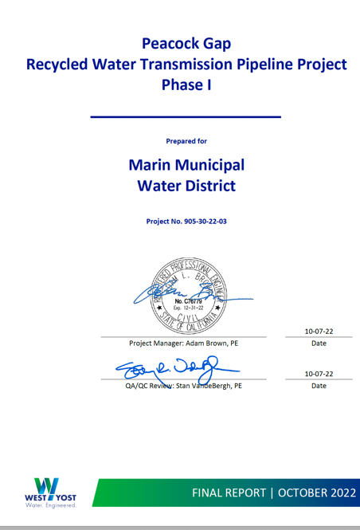
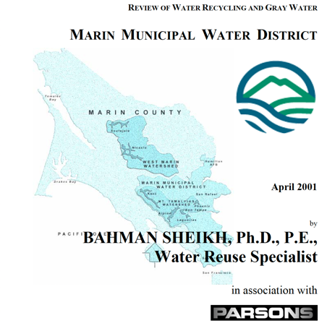
Increase Recycled Water: Expansion Studies
Planning efforts to identify opportunities for investment and expansion of recycled water system:
  2000 Recycled Water Expansion Feasibility Study
  2001 Bahman Sheikh Recycled Water Study
  2007 Feasibility Study Update
  2014 MMWD-SASM Recycled Water Feasibility Study
  2016 MMWD-CMSA Recycled Water Feasibility Study
  2017 Water Resources Plan 2040
  2022 Peacock Gap Recycled Water Preliminary Design
  2022 MMWD-CMSA Direct Potable Reuse Feasibility Study
  2023 Strategic Water Supply Assessment
Notes:
Studies have shown us that it is challenging…so how do we expand RW use in Marin?

Slide 11
Increase Recycled Water Use:
Project-based Expansion of System
Project-based expansions of recycled water system also evaluated for feasibility
Expansion projects are typically adjacent to existing recycled water system
Potable offset demands and costs are monitored and updated (SF Bay Area CCI 2023)
Project | Demand (acre-feet) | Est. Capital Cost | Annual Cost/AF
Lucas Valley Extension | 21 | $3.3M | $10,015
Mt. Tam Cemetery | 18 | $3.0M | $10,382
Circle Road | 8.3 | $2.3M | $16,449
Peacock Gap | 8.7 | $26.7M | $6,355

Slide 12
Challenges and Opportunities: Recycled Water
Drought proof supply
Expansion of recycled water in District service area is possible but high $/AF
Expanding recycled distribution system creates future long-term maintenance
Continue to pursue grant funding opportunities to improve cost-benefit of recycled “purple pipe” opportunities
Explore potable reuse options

Slide 13
Potable Reuse Options

Slide 14
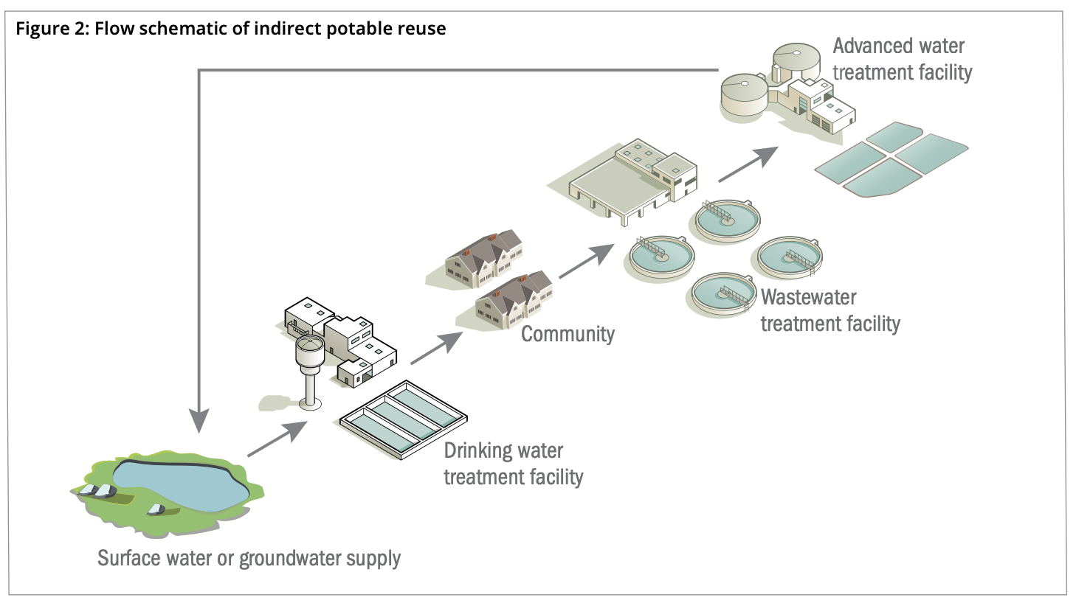
Overview: Indirect Potable Reuse (IPR)
Planned use of recycled (purified) water to replenish drinking water supplies with a suitable environmental barrier
  Two types of IPR:
    Groundwater recharge: use recycled water to replenish groundwater basin as source of municipal water supply
    Surface water augmentation: placement of recycled water into a surface water reservoir that is used as a source of domestic drinking water supply
Potable Reuse 101 - AWWA 2016
  Groundwater augmentation IPR not feasible in Marin

Slide 15
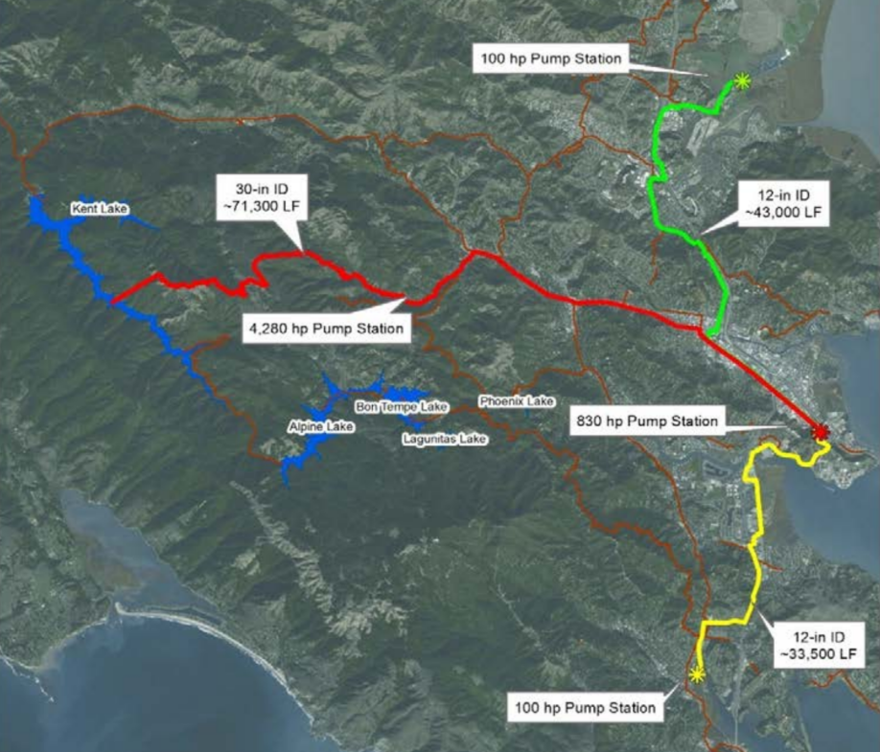
Conceptual Project in Marin: Indirect Potable Reuse (IPR)
Marin Regional IPR Project (Surface Water Augmentation)
Collect secondary effluent from LGVSD & SASM, convey to CMSA
Construct Advanced Water Purification Facility to meet Surface Water Augmentation IPR: Ultrafiltration, Reverse Osmosis, UV-AOP, conditioning
Convey purified water to Kent Lake through 28 miles of dedicated pipelines and 4 new pump stations
Expected annual yield 7,840 AFY (7 mgd)
Project | Demand (acre-feet) | Est. Capital Cost | Operations | Annual Cost/AF
Marin Regional IPR (Surf. Water Augmentation) | 7,840 | $452.0 M | Continuous | $4,504
 |  |  | Intermittent | $13,512*
From Water Resources Plan 2040 (2017)
* Cost($)/AF assumes continuous operations. Cost/AF likely to increase 3x if operated intermittently.

Slide 16
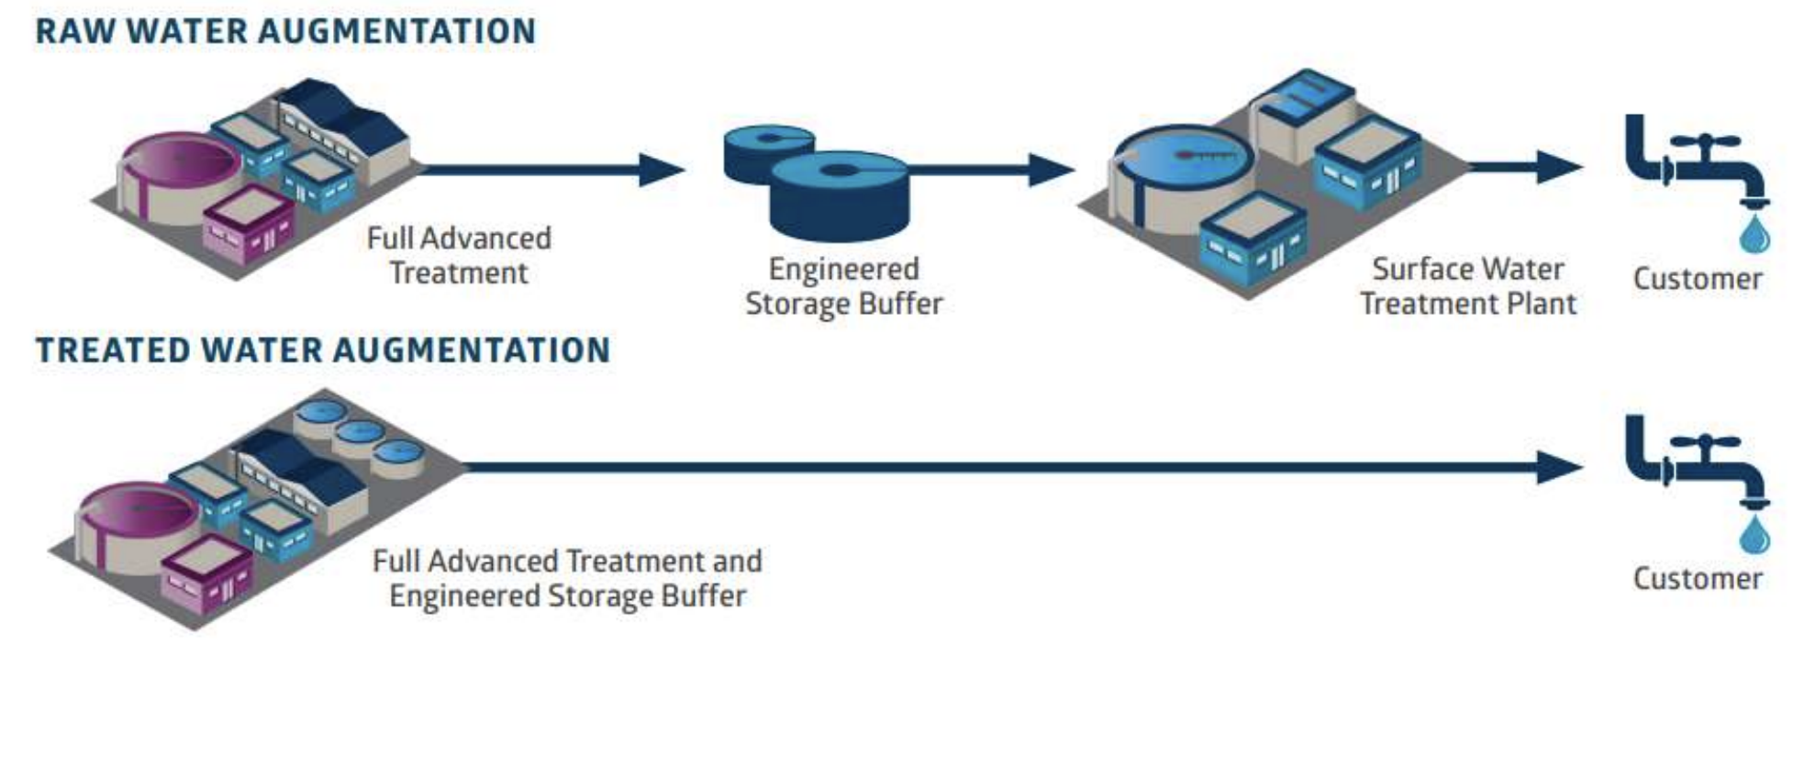
Overview: Direct Potable Reuse (DPR)
Planned introduction of purified (recycled) water either
Raw water augmentation: into a raw water supply immediately upstream of a water treatment plant
OR
Treated water Augmentation: directly into a public water system

Slide 17
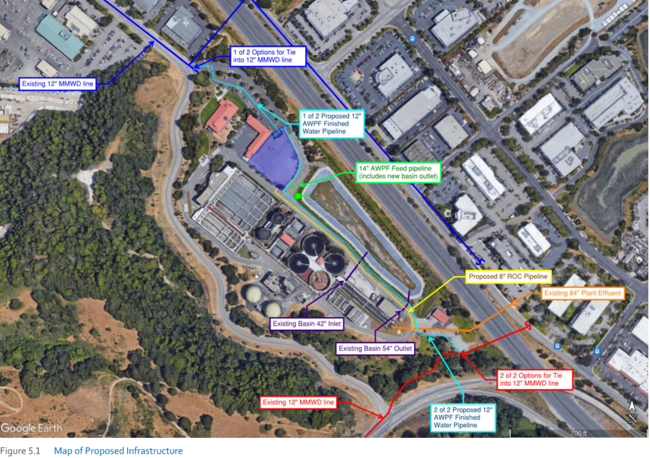
Conceptual Project in Marin: Treated Water Augmentation (DPR)
MMWD-CMSA TWA (DPR) Project
Advanced Water Purification Facility at CMSA, only treat CMSA effluent, connection to exiting distribution (treated water augmentation) up to 4 mgd
Targeted to meet DRAFT DPR treatment requirements
Treatment Trains include:
  Ozone (O3)
  Biological active carbon (BAC)
  Ultrafiltration (UF)
  Reverse Osmosis (RO)
  Ultraviolet light advanced oxidation process (UV AOP) using free chlorine
  Free chlorination
  Additional UV disinfection
  Stabilization and chloramination for distribution
From Water Resources Plan 2040 (2017)
Project | Demand (acre-feet) | Est. Capital Cost | Operations | Annual Cost/AF
MMWD-CMSA DPR (Treated Water Augmentation) | 4,480 | $124.4 M | Continuous | $3,562
 |  |  | Intermittent | $10,686*
* Cost($)/AF assumes continuous operations. Cost/AF likely to increase 3x if operated intermittently.

Slide 18
Considerations: Direct Potable Reuse
Public acceptance – No implementation of treated water augmentation in the US
Regulations are still under review – earliest effective date is mid-2024, subject to refinement over time
Constituents of concern
  Trace contaminants – pharmaceuticals, PFAS, personal care products, other trace organics;
  Concentrate management – RO concentrate discharged to Bay
Introduces different water sources for different parts of service area
Not designed to be intermittently operated

Slide 19
Summary and Next Steps
Expansion of (purple pipe) recycled water in District service area is possible but capital intensive
  Pursue grant opportunities to help fund recycled water projects
Monitor industry regulations, trends and technological advances such as DPR
Consider multi-benefit opportunities with sewage agencies as SF Bay nutrient regulations move forward
  Irrigation with recycled water ideal for nutrient removal (vs IPR and DPR which concentrate nutrients)
Continue to evaluate and prioritize reuse opportunities as a component of overall Water Supply Roadmap implementation

